Slide 1
Sequential Circuit Latches and Flip Flop

Slide 2
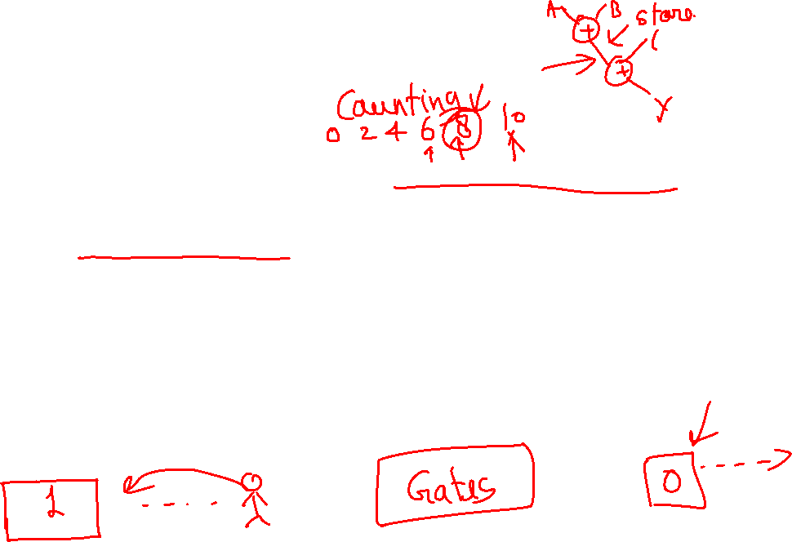
Need of New kind of Circuit
Logical operations which respond to combinations of inputs to produce an output.
Call these combinational logic circuits.
For example, can add two numbers. But:
No way of adding two numbers, then adding a third (a sequential operation);
No way of remembering or storing information after inputs have been removed.
To handle this, we need sequential logic capable of storing intermediate (and final) results.

Slide 3
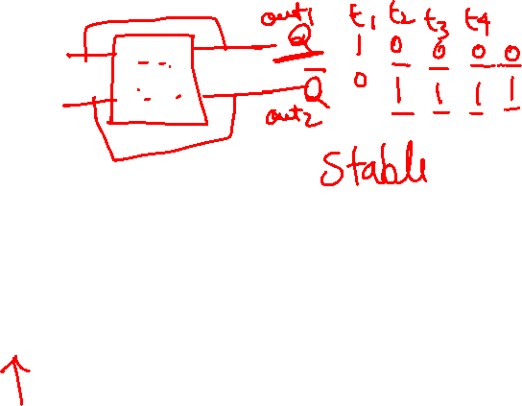
Sequential Circuits
Inputs
Combinational circuit
Outputs
Storing

Slide 4

S-R Latch with NORs
R (reset)
Q
S R Q Q’
1 1
1 0
0 1
0 0
0 0 Undefined
1 0 Set
0 1 Reset
Q
S (set)
0 1
Store/Memory
1 0
S-R latch made from cross-coupled NORs
If Q = 1, set state
If Q = 0, reset state
Usually S=0 and R=0
S=1 and R=1 generates unpredictable results

Slide 5
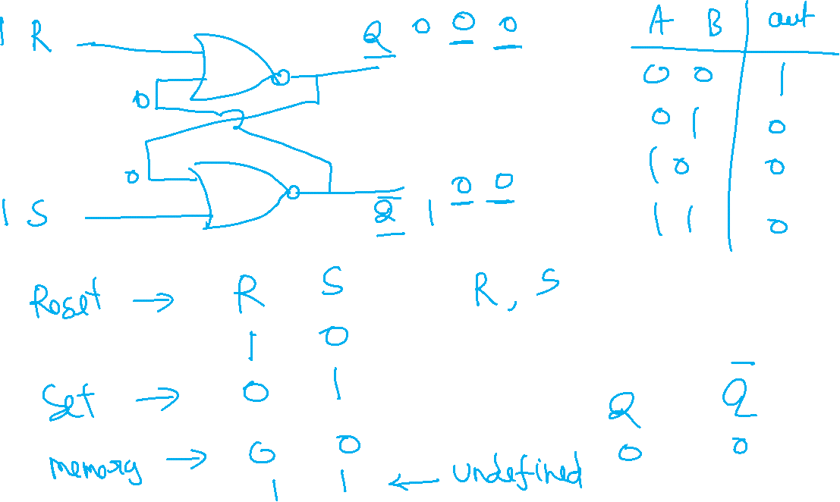

Slide 6

Verilog code
module SR_latch_gate (input R, input S, output Q, output Qbar);
nor (Q, R, Qbar);
nor (Qbar, S, Q);
endmodule
module SR_latch_dataflow (input R, input S, output Q, output Qbar);
assign #2 Q = ~ (R | Qbar);
assign #2 Qbar = ~ (S | Q);
endmodule

Slide 7

S-R Latch with NANDs
S R Q Q’
S
Q
0 0
0 1
1 0
1 1
1 1 Disallowed
1 0 Set
0 1 Reset
Q’
0 1
Store
R
1 0
Latch made from cross-coupled NANDs
Sometimes called S’-R’ latch
Usually S=1 and R=1
S=0 and R=0 generates unpredictable results

Slide 8
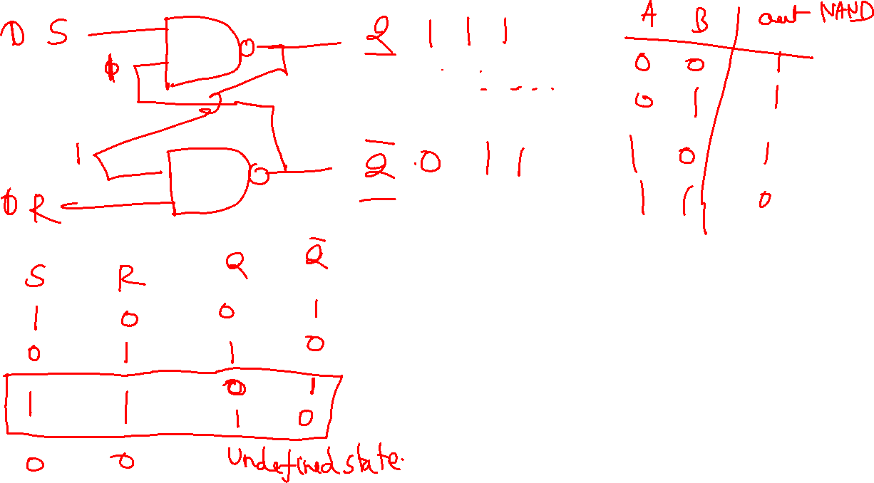

Slide 9
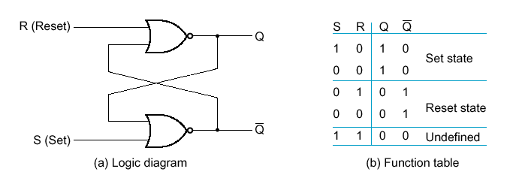
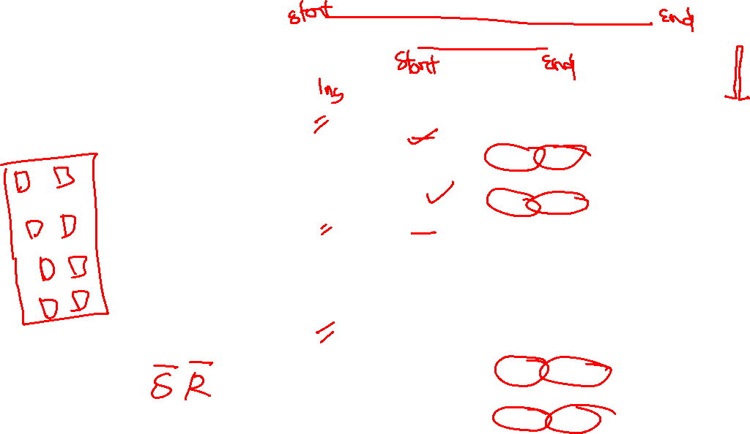
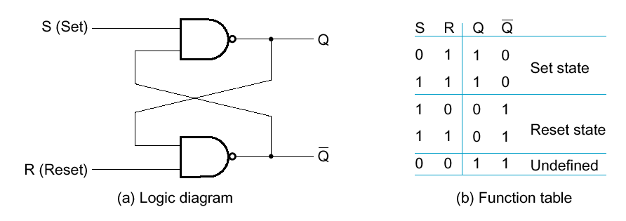
S-R Latches

Slide 10
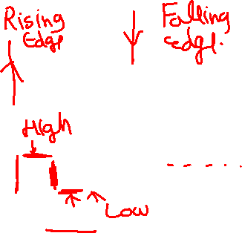
External Input to control the circuit
Clock
a periodic external event (input)
Clock
synchronizes when current state changes happen
keeps system well-behaved makes it easier to design and build large systems

Slide 11
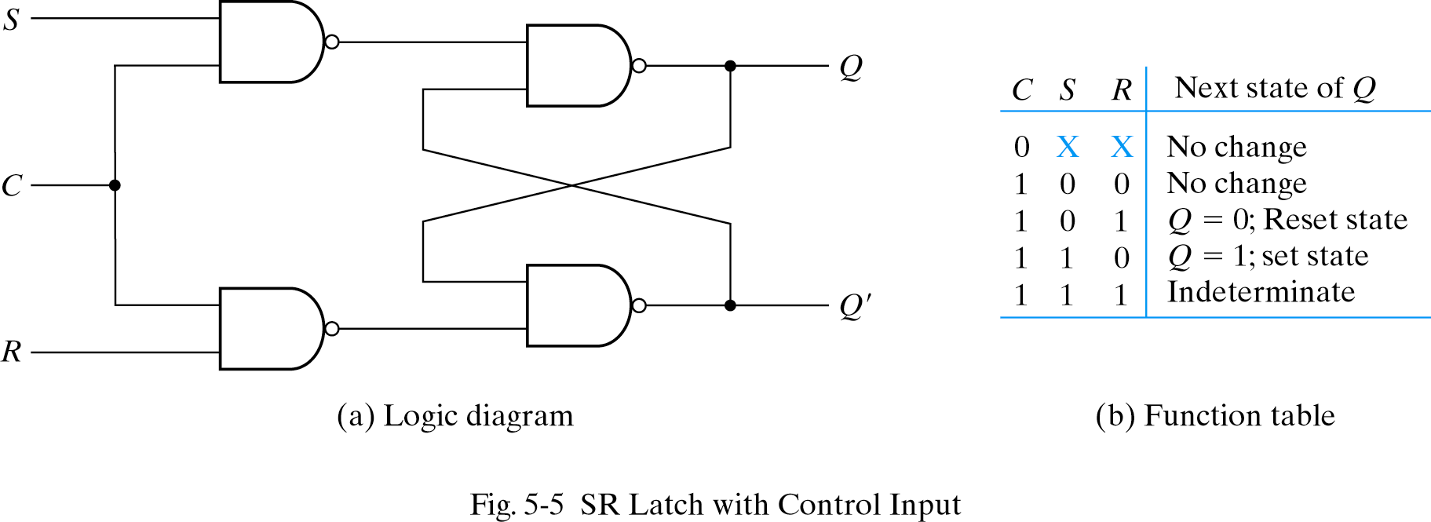
S-R Latch with control input/ S-R flip Flop
Occasionally, desirable to avoid latch changes
C = 0 disables all latch state changes
Control signal enables data change when C = 1
Right side of circuit same as ordinary S-R latch.

